Slide 1
Greater Hartford Interfaith Action Alliance
August 18, 2022

Slide 2
Contact Us
For questions or comments about the information presented today, please contact us:
Erika Haynes, Director of Community Engagement
Email: erika.haynes@schoolstatefinance.org
Cell: 860-336-6902
Jen Nakos, Community Engagement Associate
Email: jen.nakos@schoolstatefinance.org
Cell: 203-339-1914
To learn more about the
School and State Finance Project, visit us at:
www.schoolstatefinance.org
Or connect with us on social media

Slide 3
About the School and State Finance Project
Founded in 2015, the School and State Finance Project is a nonpartisan, nonprofit policy organization, focused on education funding and state finance issues.
Our organization is committed to providing independent analysis, building public knowledge, improving transparency, and developing fair, sustainable solutions for some of the toughest education funding and state finance challenges.
Although not a member-based organization, we actively work with a diverse group of stakeholders and communities.
We aim to serve as a trusted resource for policymakers, school district officials, community leaders, and all individuals looking for transparent, accessible, and approachable information about education funding and state finances.

Slide 4
Table of Contents
Overview | 5
Where You Live Matters | 9
The Role of Wealth and Property Taxes | 13
Racial Disparities in Education Funding | 19
Education Cost Sharing Formula | 23
Sheff Movement | 35
How Other Public Schools Receive Funding | 40
What You Can Do | 52

Slide 5
overview

Slide 6
Right to a free public education
Education is not a fundamental right under the United States Constitution.
However, all 50 states guarantee the right to a free public education in their constitutions.
Public schools fall under the authority of state government and are primarily funded through state and local tax dollars.

Slide 7
How Much Connecticut Spends on K-12 Education
K-12 education spending represents roughly 15% of the state budget, or $3.1 billion.
Of that, nearly two-thirds, or $2.1 billion, goes to Education Cost Sharing (ECS) grants.

Slide 8
What are the funding sources for K-12 education in Connecticut?
Percent
4.8%
37.2%
58.0%
$12.0B
Source: U.S. Census Bureau. (2021). Table 1: Summary of Public Elementary-Secondary School System Finances by State: Fiscal Year 2019. 2019 Annual Survey of School System Finances. Washington, DC: Author. Available from https://www2.census.gov/programs-surveys/school-finances/tables/2019/secondary-education-finance/elsec19_sumtables.xls.

Slide 9
Where you live matters

Slide 10
Connecticut Communities
There are 169 cities/towns in Connecticut, each with its own local government.
Since 1909, students in Connecticut have been assigned to the public school district in which they live.
School districts reflect town boundaries, although regional school districts and choice school programs frequently cross town boundaries.

Slide 11
Zoning Practices
Each community in Connecticut has their own zoning committee to decide how land within the town should be used. This impacts who can afford to move to and live in the community.
The zoning committee works together to decide a variety of rules and practices. Some examples include:
A minimum lot size (needing a certain amount of land to build a house on it)
Types of housing (Two-family homes or apartment buildings vs. traditional single family homes)
Floor size minimums (Can you build a smaller house? Or is there a certain minimum square footage for all homes?)
Parking mandates (How many street parking spaces do you need to include when building a home?)
When these zoning regulations result in exclusion of certain community members, they’re referred to as “exclusionary zoning practices”

Slide 12
Segregated Communities
Housing segregation and zoning policies play a large role in the concentration of BIPOC students in a handful of districts.
Approximately 60% of Black students in the state attend a district where the white student population is less than 25% of the district’s total enrollment.
This means that even though the statewide population of BIPOC students versus white students is nearly evenly split, a majority of BIPOC students are actually concentrated in just a handful of districts.

Slide 13
The role of wealth and property taxes

Slide 14
One of the most fundamentally flawed parts of education funding is its reliance on local property taxes.
It enables an inequitable system where affluent, predominantly white communities are able to fund their schools at higher levels.

Slide 15
Property Taxes
Cities and towns raise money to pay for town services (including public schools) through property taxes.
Cities and towns are able to collect tax on property that is owned by the people who live there.
Cities and towns can collect taxes on “real” property (e.g. office building, apartment buildings, houses) and “personal” property (e.g. cars and boats).
Property that belongs to some nonprofit organizations, like universities, hospitals, and churches, may be exempt from property tax.
Source: State of Connecticut, Office of Policy and Management. (n.d.). Statutes Governing Property Assessment and Taxation. Retrieved from https://portal.ct.gov/OPM/IGPP-MAIN/Services/Statutes-Governing-Property-Assessment-and-Taxation

Slide 16
Grand List & Mill Rates
The value of a town’s taxable property is called a grand list.
The rate at which personal property is taxed by a town is known as a mill rate.
Communities with a higher grand list need to tax less in order to generate funding for their schools. Communities with a lower grand list must tax more in order to generate funding for their schools.

Slide 17
The Value of Grand Lists Varies Widely
Municipality | Equalized Net Grand List GLYR 2018
GREENWICH | $49,305,412,148
STAMFORD | $33,352,891,564
NORWALK | $20,400,626,724
FAIRFIELD | $16,727,103,155
WESTPORT | $15,922,769,472
… | …
HARTFORD | $7,617,691,245
… | …
SPRAGUE | $262,421,803
EASTFORD | $221,369,501
HAMPTON | $210,897,474
SCOTLAND | $159,566,580
UNION | $132,309,249
$49.2B
Source: State of Connecticut, Office of Policy and Management. (2021). Municipal Fiscal Indicators, Fiscal Years Ended 2015-2019. Hartford, CT: Author. Retrieved from https://portal.ct.gov/-/media/OPM/IGP/munfinsr/Municipal-Fiscal-Indicators/FI-2015-19-Final-AsOf-4-30-21.pdf.

Slide 18
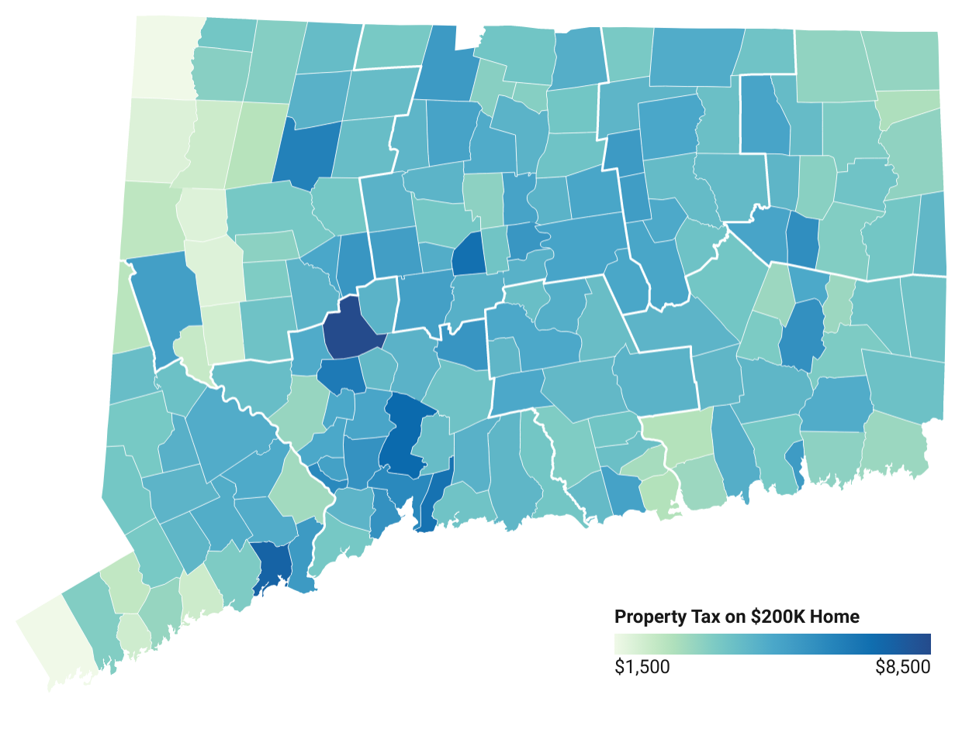
Property Taxes on a $200,000 House
Sharon: $2,016
West Hartford: $3,500
New Britain: $7,070
Hartford: $5,200
Waterbury: $8,429
Norwich: $5,888
New Haven: $6,143
Stonington: $3,270
Bridgeport: $7,559
New London: $5,499
Greenwich: $1,623

Slide 19
Racial Disparities in education funding

Slide 20
$713 million
Funding gap between districts serving student populations that are less than 25% BIPOC and all other districts.

Slide 21
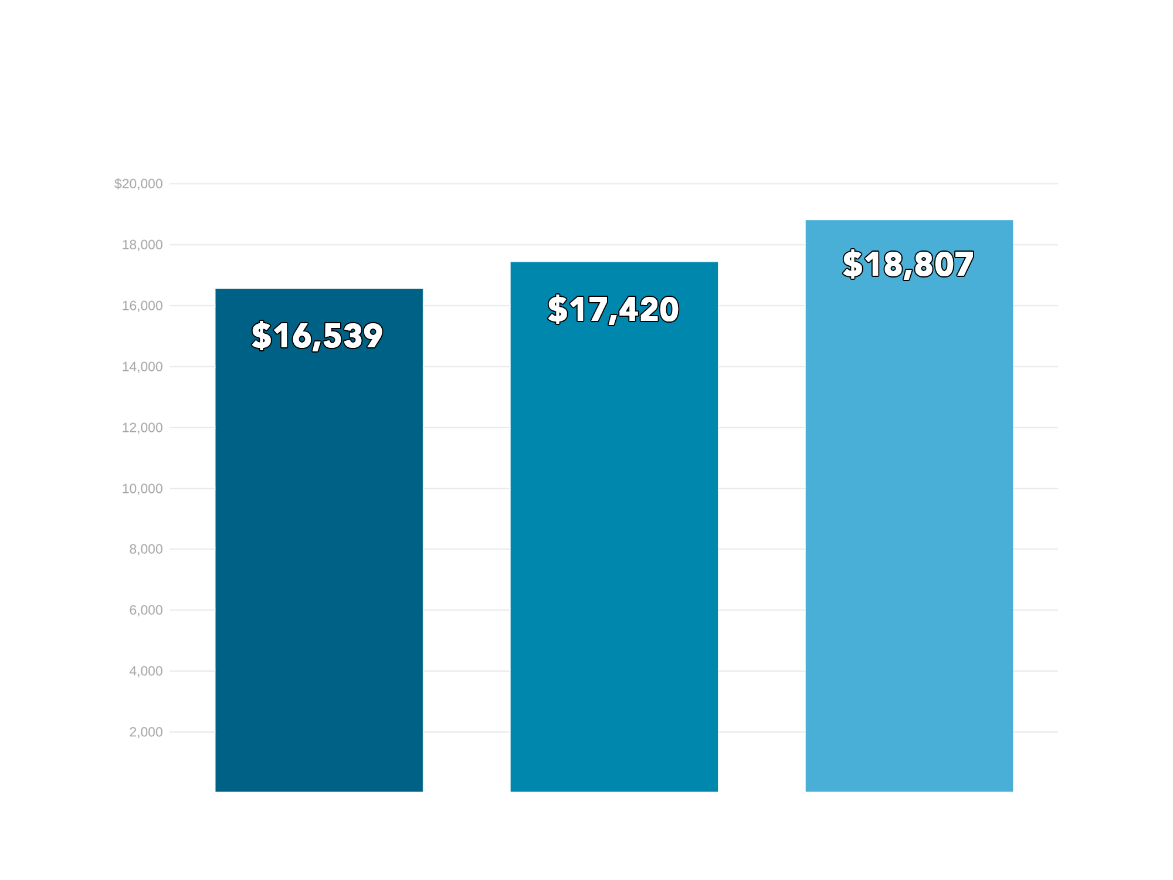
Districts whose student populations are > 75% BIPOC students spend roughly $2,300 less per student than districts with populations of < 25% BIPOC students
> 75%
BIPOC
25%-75% BIPOC
< 25%
BIPOC

Slide 22
What $2,300 Less Per Student
Actually Means
$66,700 less for a classroom of 29 students
$1,150,000 less for an elementary school

Slide 23
State Funding
Via
The Education Cost Sharing Formula (ECS)

Slide 24
The ECS formula is used to distribute state education aid to municipalities for their local or regional public school districts

Slide 25
Why CT Has an ECS Formula
The state began providing aid to cities/towns as a result of a 1977 CT Supreme Court decision, Horton v. Meskill.
In Horton (1977), the Court ruled that an education funding system that allows “property wealthy” towns to spend more on education with less effort, is a system that impedes children’s constitutional rights to an equal education.
As a result, CT established a formula to give money to public school districts that took property wealth into consideration.
In 1988, CT established the Education Cost Sharing (ECS) formula to serve this purpose. It has been revised numerous times since.
In theory, the ECS grant is supposed to make up the difference between what a community can afford to pay and what it costs to run a public school system.
Sources: Horton v. Meskill, 172 Conn. 615 (Conn. Sup. Ct. 1977). Connecticut General Assembly, Office of Legislative Research. (2013). Task Force to Study State Education Funding Final Report. Retrieved from http://www.cga.ct.gov/2013/rpt/2013-R-0064.html.

Slide 26
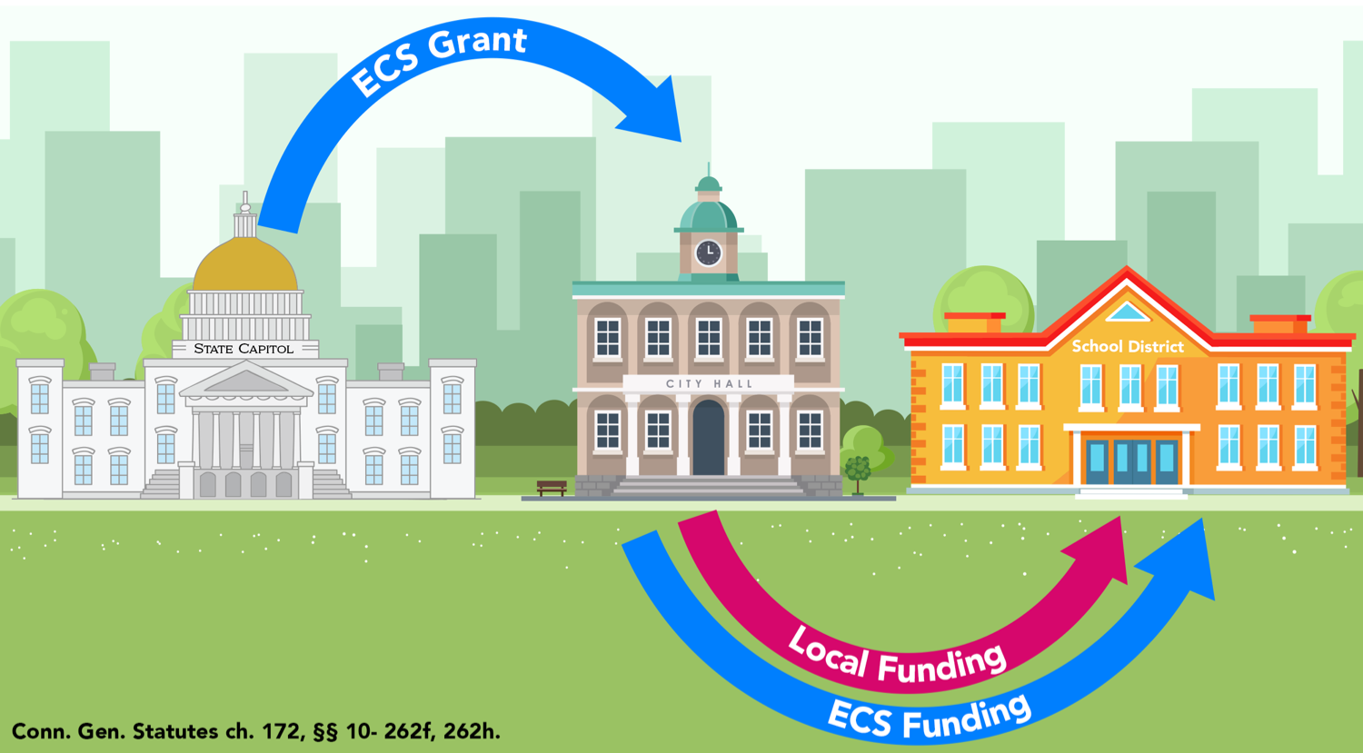
How ECS Funding Flows

Slide 27
Foundation Amount
Education Cost Sharing begins with a foundation amount; that is, the amount of money it costs to education a child with no additional needs, a neurotypical general education student
In Connecticut, the foundation amount is established by the legislature
Currently, the foundation amount is $11,525
Source: Conn. Gen. Statutes ch. 172, § 10-262f.

Slide 28
ECS Formula’s Student-Need Weights
Low-Income Student Weight | 30%
Concentrated Poverty Weight Applied to Every Student Above 60% Concentrated Poverty | 15%
English Learner Weight | 25%

Slide 29
Student Need | Funding Per Student
General Education (Non-need) Student | $11,525
Low-income Student (+ $3,458) | $14,983
Concentrated Low-income Student (+ $5,186) | $16,711
Low-income and English Learner (+6,339) | $17,864
English Learner (+$2,881) | $14,406
Concentrated Low-income English Learner (+8,067) | $19,592
Source: Conn. Gen. Statutes ch. 172, § 10-262f.
All numbers are rounded

Slide 30
Base Aid Ratio
A town’s ability to fund its public schools is determined by two factors in the ECS formula. These factors make up the Base Aid Ratio.
Property Wealth Factor | 70%
Income Wealth Factor | 30%

Slide 31
Additional Funding for Towns in Need
Formula adds additional funding for 19 communities that have a Public Investment Communities (PIC) index score of over 300.
PIC index is calculated annually by the OPM and measures the relative wealth and need of CT’s towns
If a town has one of the top 19 highest PIC Index scores, under the formula, the town will receive a bonus of three to six percentage points to its Base Aid Ratio, which determines each community’s ability to financially support its public schools
Town’s PIC Index Rank | Additional % Points Added to Base Aid Ratio
1-5 | 6 percentage points
6-10 | 5 percentage points
11-15 | 4 percentage points
16-19 | 3 percentage points
Source: Conn. Gen. Statutes ch. 172, § 10-262f.

Slide 32
Factors Impacting a Town’s ECS Grant
Town’s 2017 ECS grant amount
# of students residing in town
# of economically disadvantaged students
% of students who are economically disadvantaged
# of students learning English
# of students sent to regional school districts, and how many grades the regional district has
Town’s property wealth (ENGLPC)
Income of town residents (Median Household Income)
PIC Index score
Alliance District status

Slide 33
Phase-In Schedule
Formula began implementation in FY 2019
Towns receiving increases will be phased in over 10 years (towns receive full funding in 2028)
Towns receiving decreases will be phased out over 12 years (phase-out paused for FY 2022-23)
Alliance Districts that would otherwise receive a decrease their grant amount are permanently held harmless at their FY 2017 ECS grant amount.
Phase-in Schedule
 | FY 2022-2023 | FY 2024-FY 2027 | FY 2028-2029 | FY 2030
Towns Receiving Increase in ECS Funding Over FY 2017 Grant | Increase phased in by 10.66% per year |  | Towns receive 100% of their ECS grant, as calculated by formula
Towns Receiving Decrease in ECS Funding Compared to FY 2017 Grant | Phase-in paused | Decrease phased out by 8.33% per year |  | Towns receive 100% of their ECS grant, as calculated by formula
Source: Conn. Gen. Statutes ch. 172, § 10-262h.

Slide 34
Students who were kindergarteners at the start of the phase-in will not see full funding until they’re in high school

Slide 35
Sheff movement

Slide 36
Sheff v. O’Neill (1989)
In 1989, 19 public school students and their families filed a lawsuit against the State of Connecticut with 3 fundamental claims:
Students in Hartford Public Schools were being denied educational opportunities and outcomes equal to those of their white suburban student counterparts, due to the segregated and economic disparities. This was cited as a violation of the state constitution,
By failing to act, the defendants were discriminating against children in Hartford, violating the guarantee of equal education opportunity under the state’s constitution, and
Due to concentrated poverty, a condition closely aligned with racial segregation, Hartford schools were fundamentally overburdened, failing to provide a “minimally adequate education.”

Slide 37
Sheff v. O’Neill Ruling (1996)
Connecticut’s Supreme Court, in a 4-3 decision, ruled in favor of the plaintiffs. The court ruled the following:
The majority determined “the existence of extreme racial and ethnic isolation in the school system deprives school children of a substantially equal educational opportunity and requires the state to take further remedial measures.”
The court noted that the way Connecticut applies school district boundaries, matching the municipal boundaries, resulted in a segregated education system that the state was required to fix.

Slide 38
An Act Enhancing Educational Choices and Opportunities (1997)
A 3-part response published in response to the 1996 Sheff ruling:
A five-year state takeover of the Hartford school system;
A major new commitment to early childhood education throughout the state and;
An implementation of a two-way voluntary integration program, including a new regional magnet school system and expansion of the interdistrict transfer program, “Open Choice” (prev: Project Choice)
*There have been many times the plaintiffs have had to go back to court, resulting in settlement and stipulated agreements in subsequent years.

Slide 39
Impacts of the Sheff v. O’Neill Case: The Choice Program
The State of Connecticut has created a system of choice in the Sheff region, which includes the Hartford Public School System, in an attempt to racially diversify its schools.
The Choice Program has:
Provided the opportunity for 18,000 students to be currently enrolled in one of the 40 Sheff magnet schools and;
Provided the opportunity for over 2,000 students to be able to currently participate in the Open Choice program, in 27 schools across the Sheff region.

Slide 40
How Do Other Public School Students Receive Funding?

Slide 41
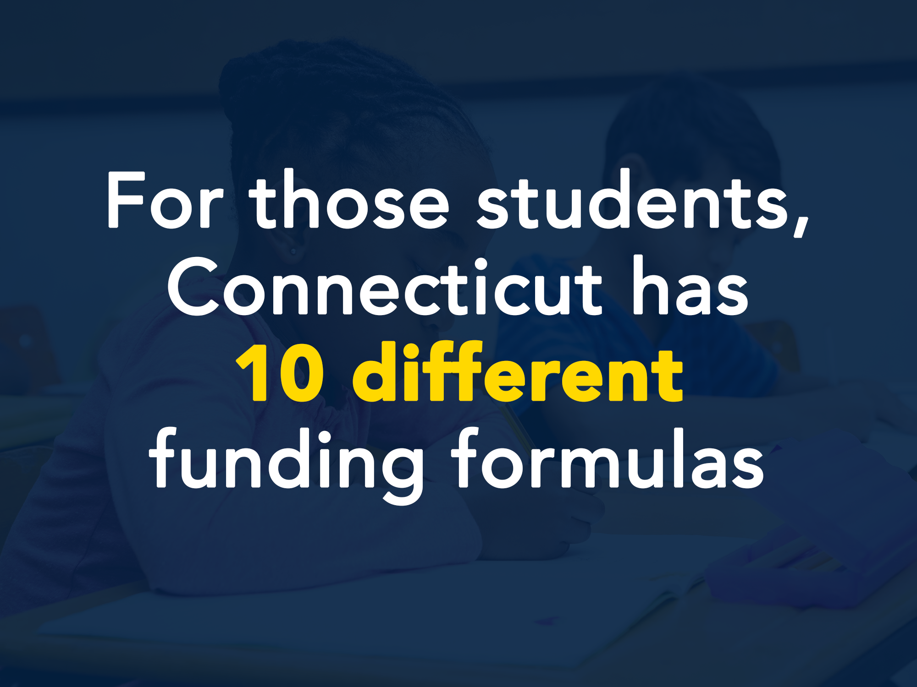
CT Has More than 10 different funding formulas

Slide 42
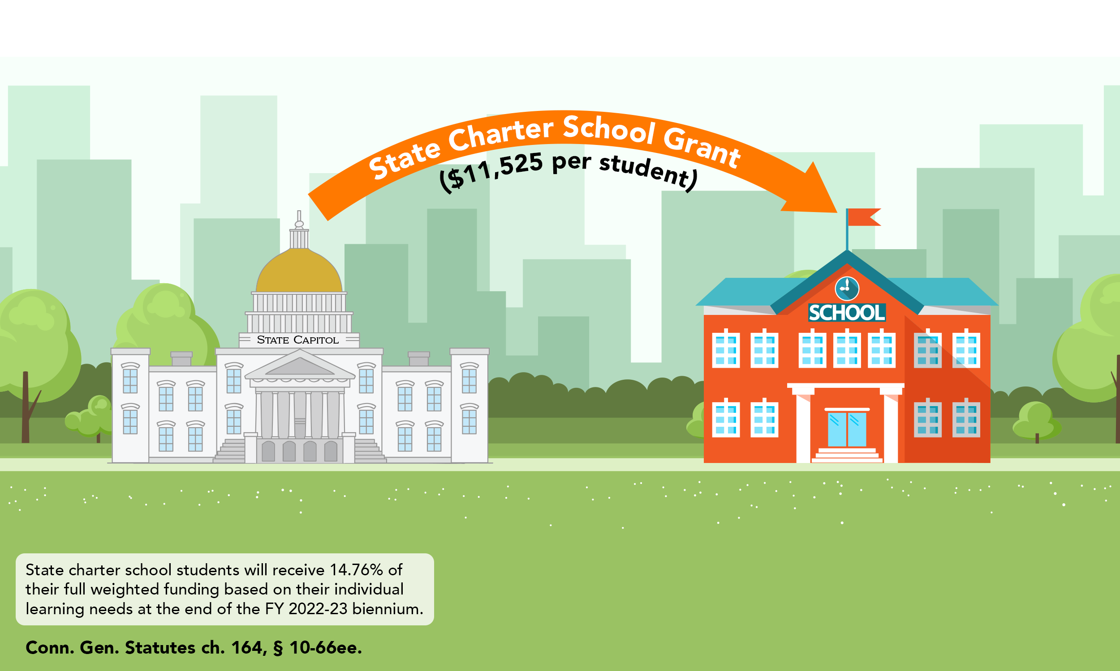
State Charter Schools
(21 schools)

Slide 43
Local Charter Schools
(1 school)

Slide 44
CT Technical Education and Career System
(20 schools)

Slide 45
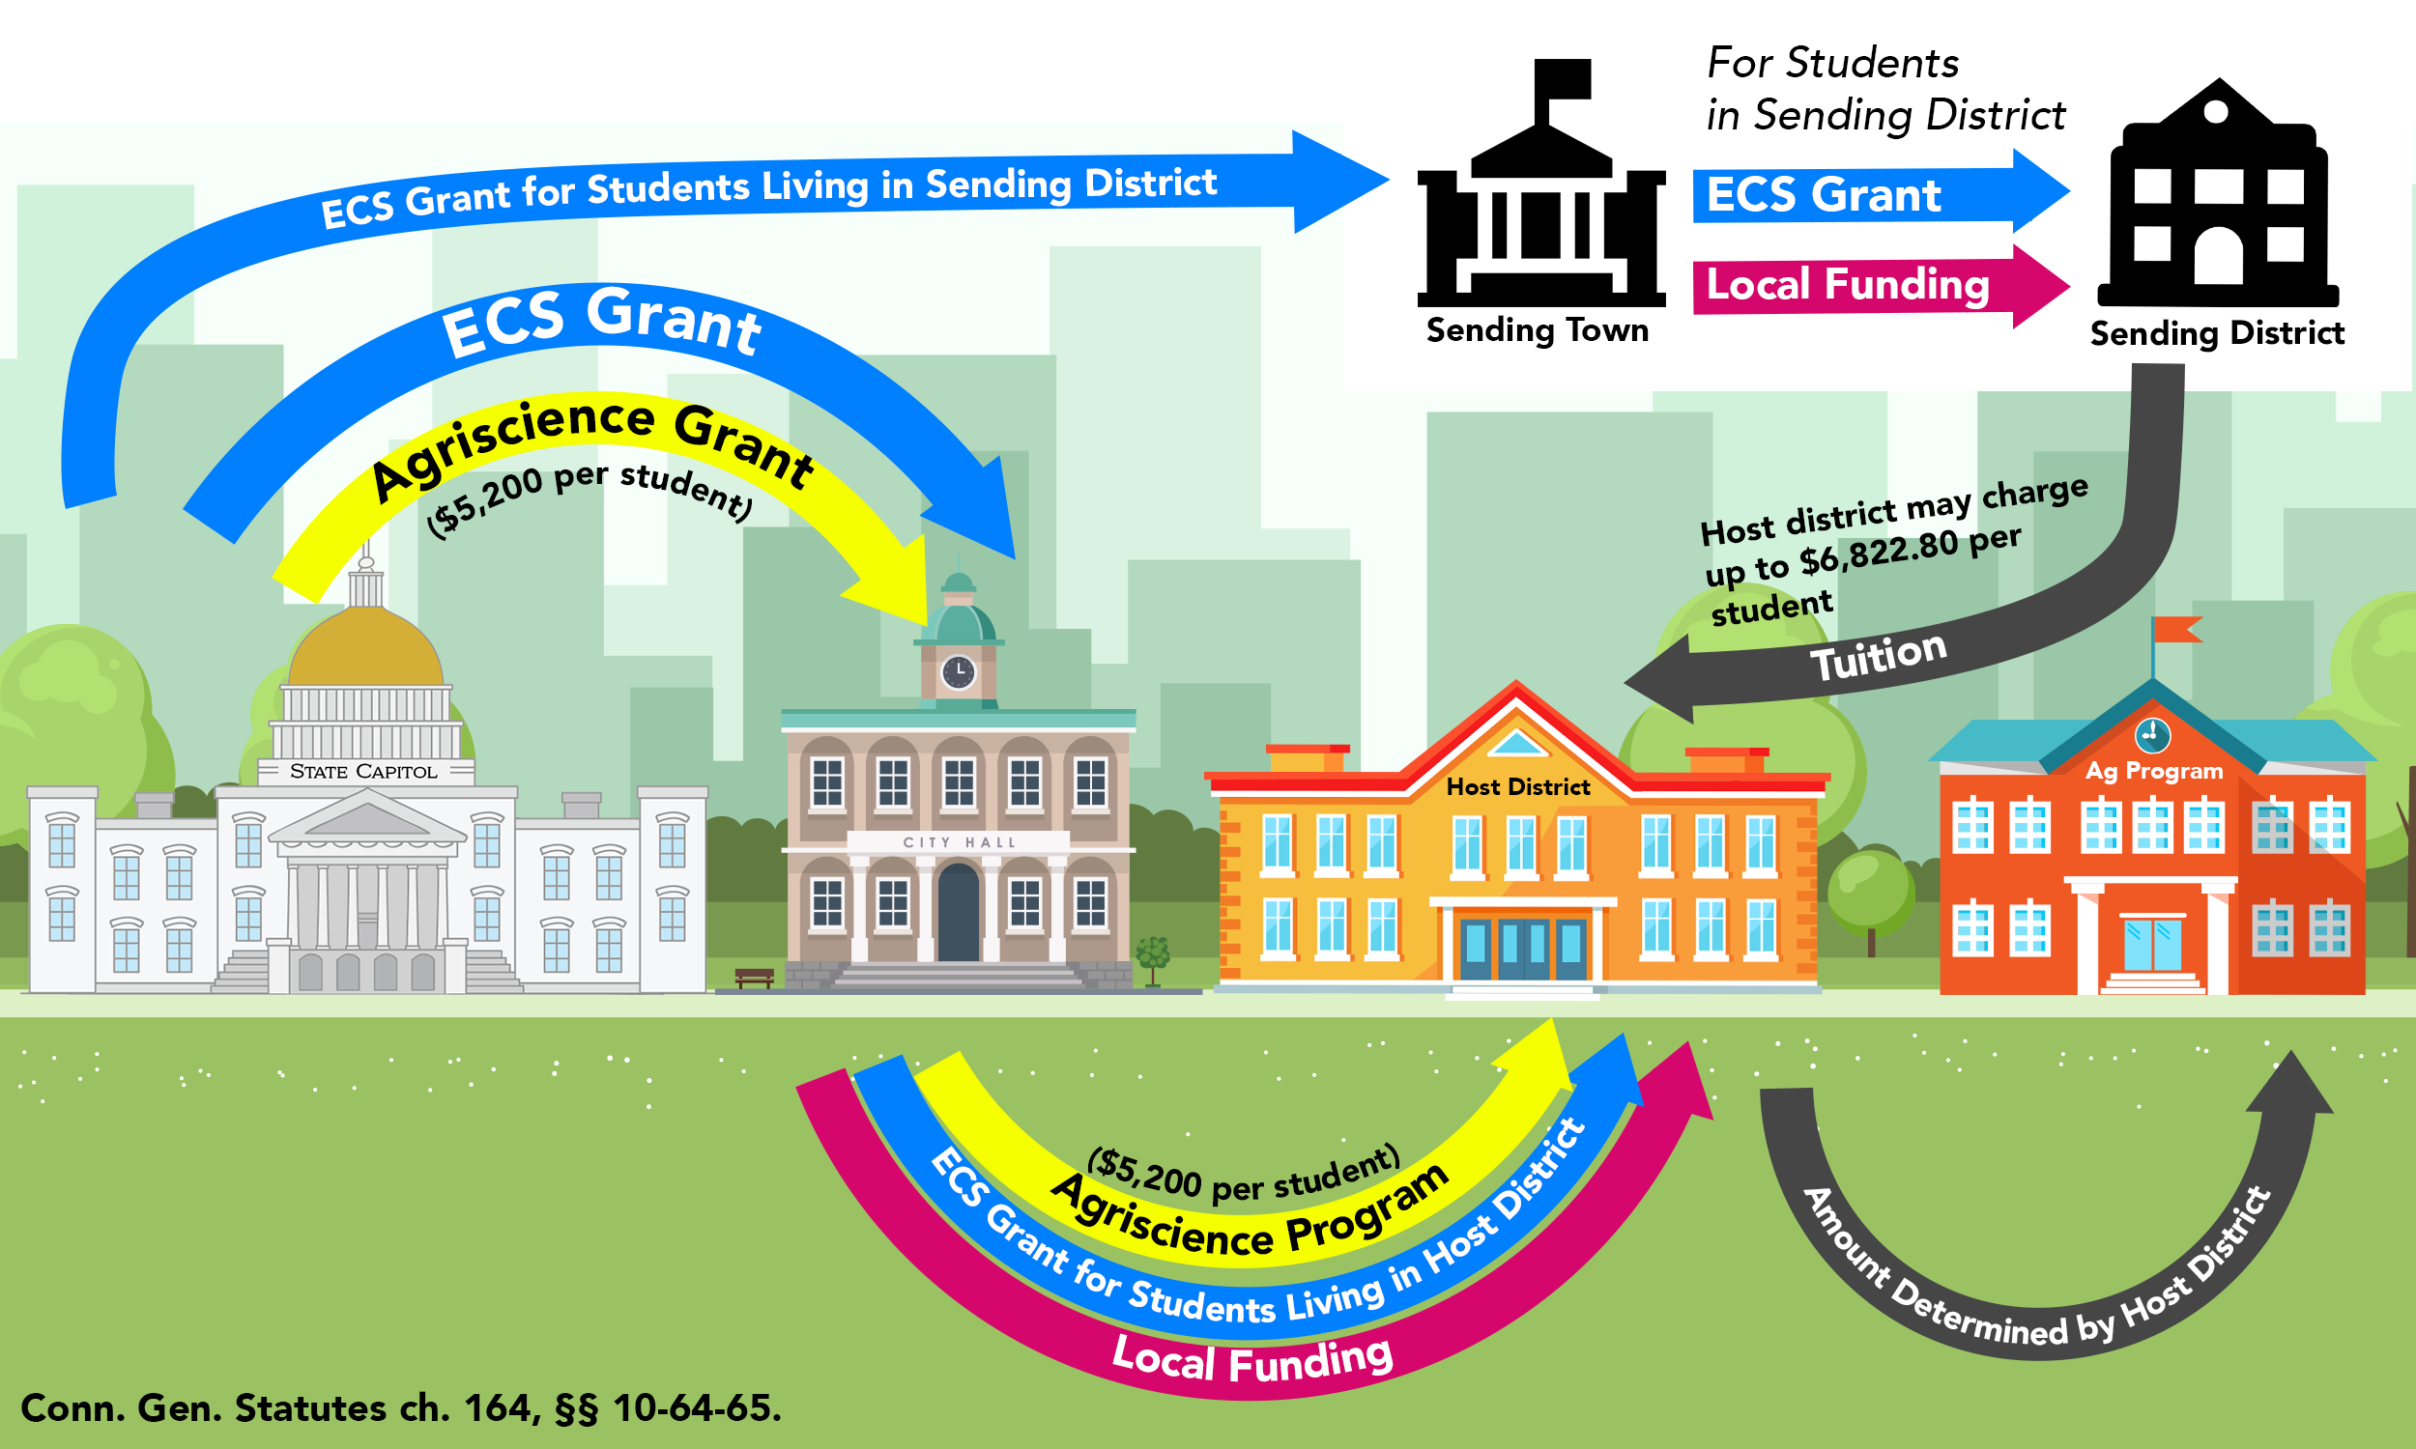
Agriscience Program
(20 centers)

Slide 46
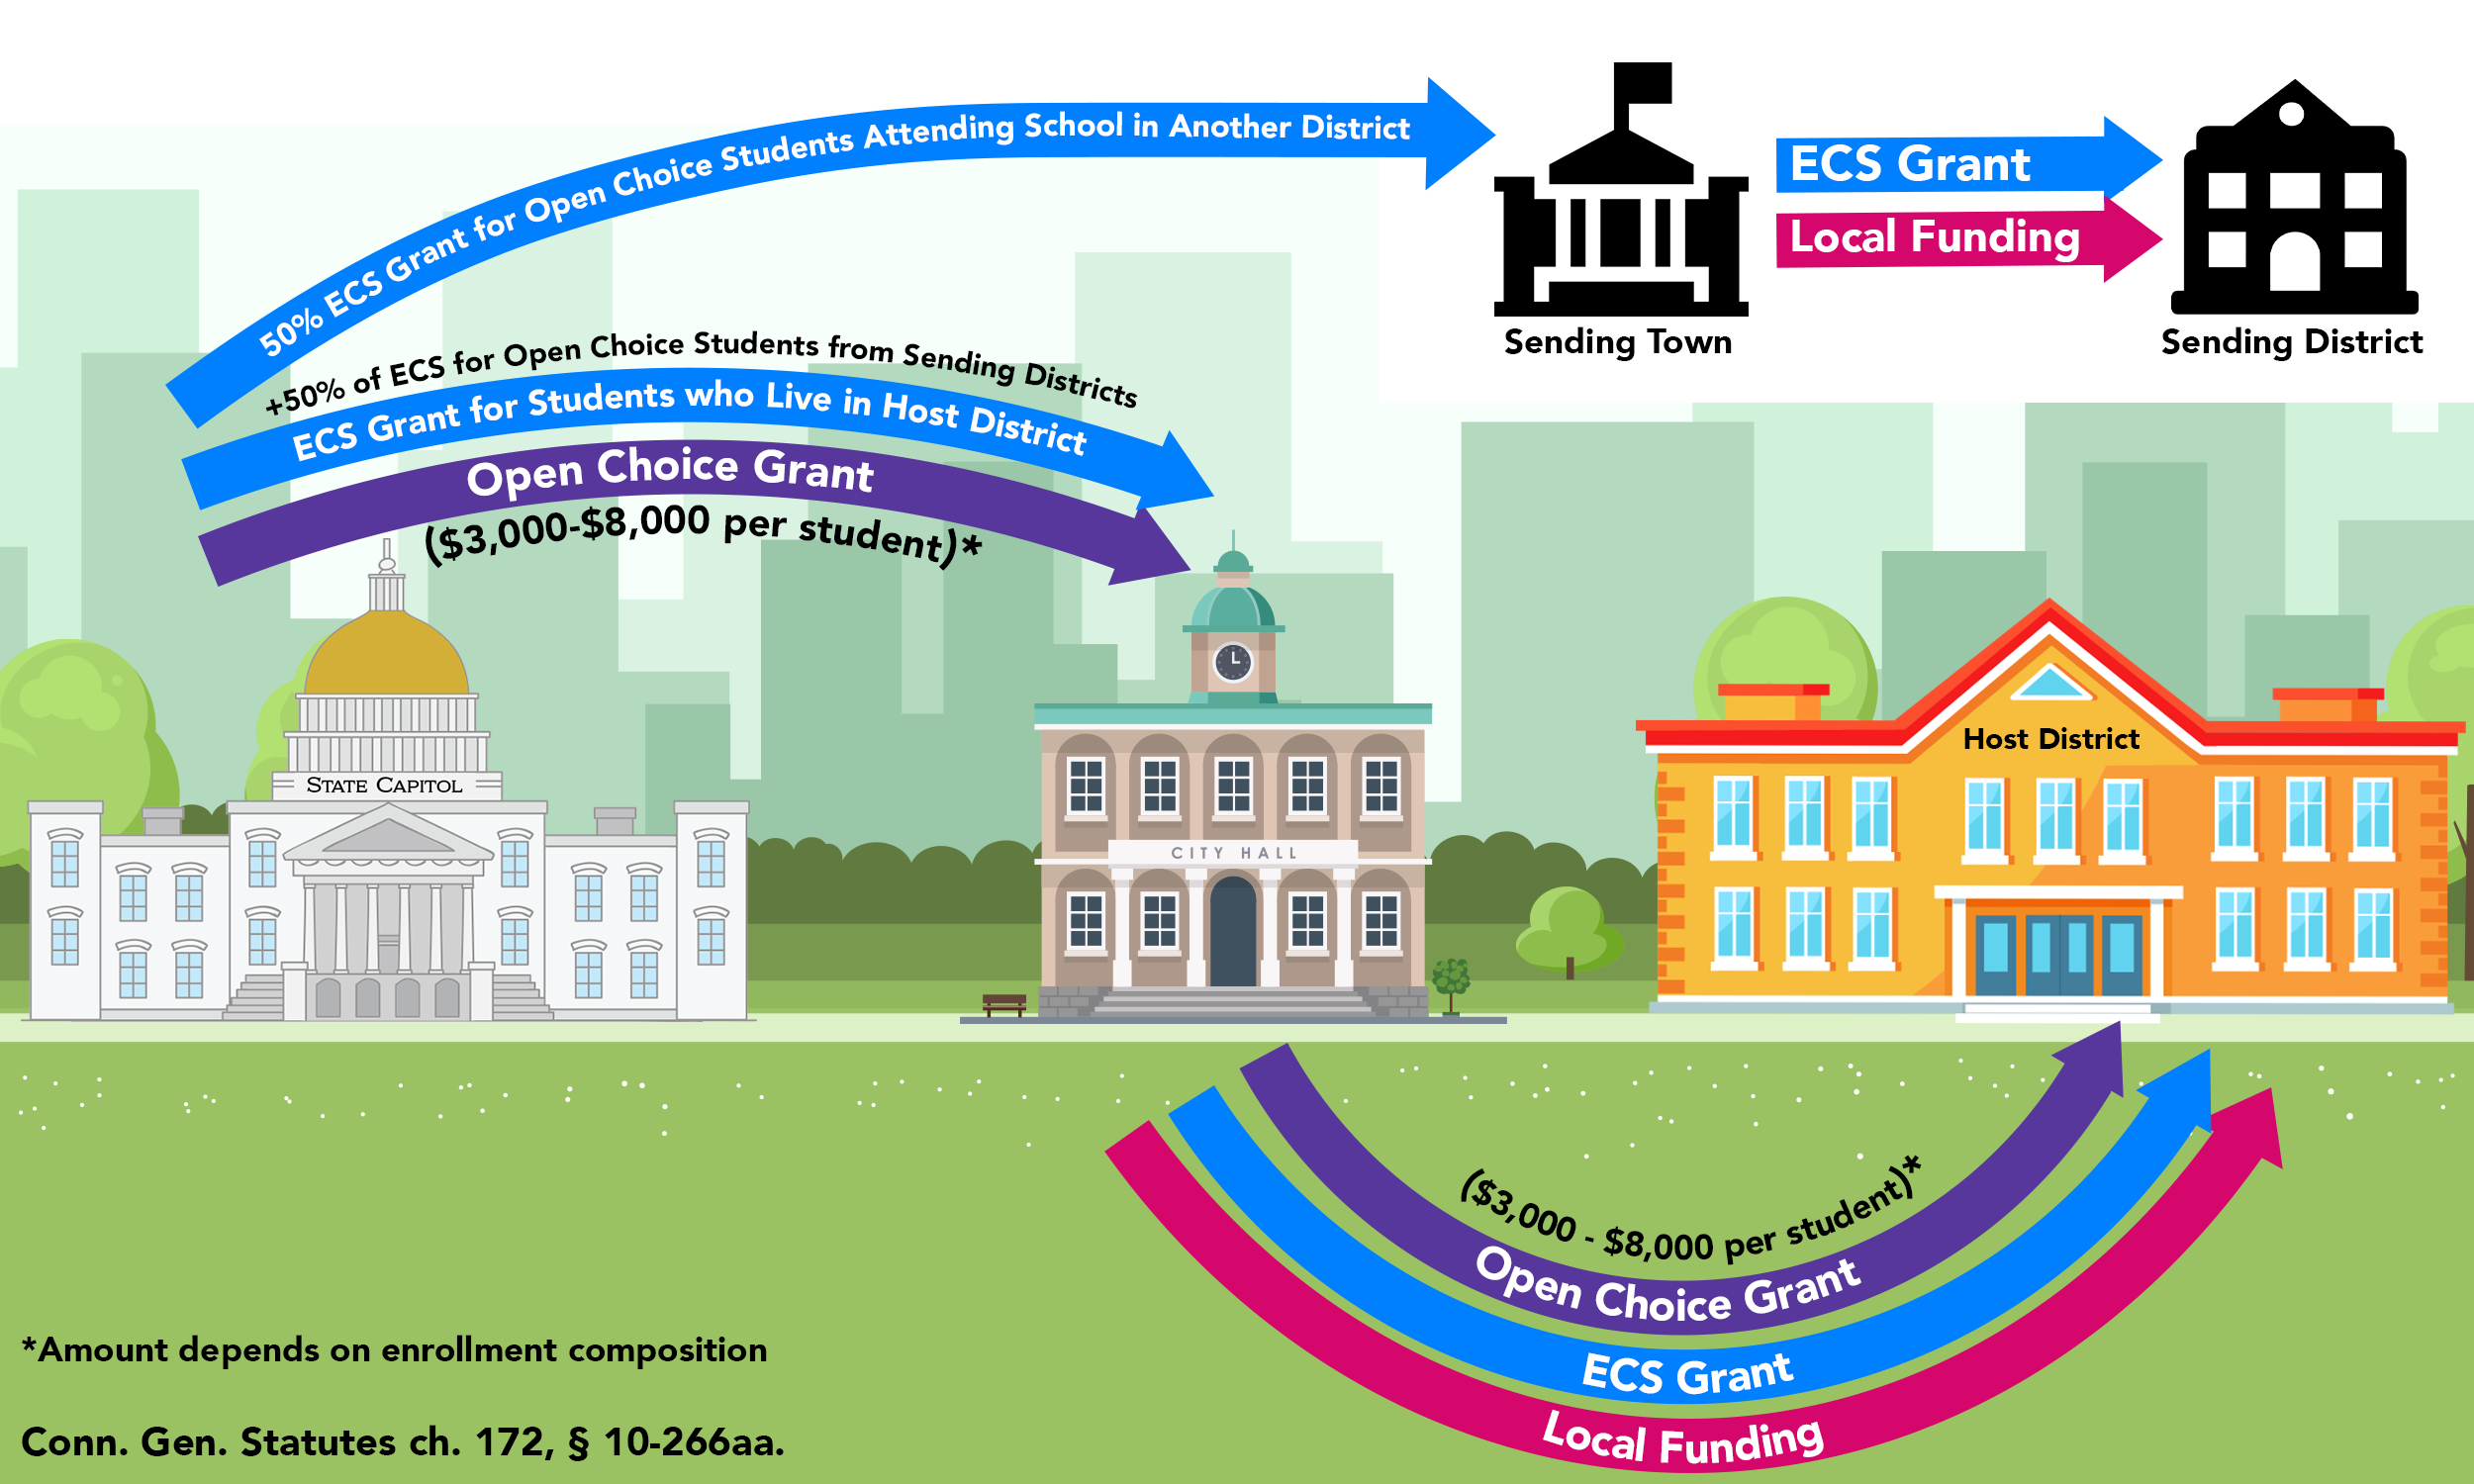
Open Choice
(47 participating districts)

Slide 47
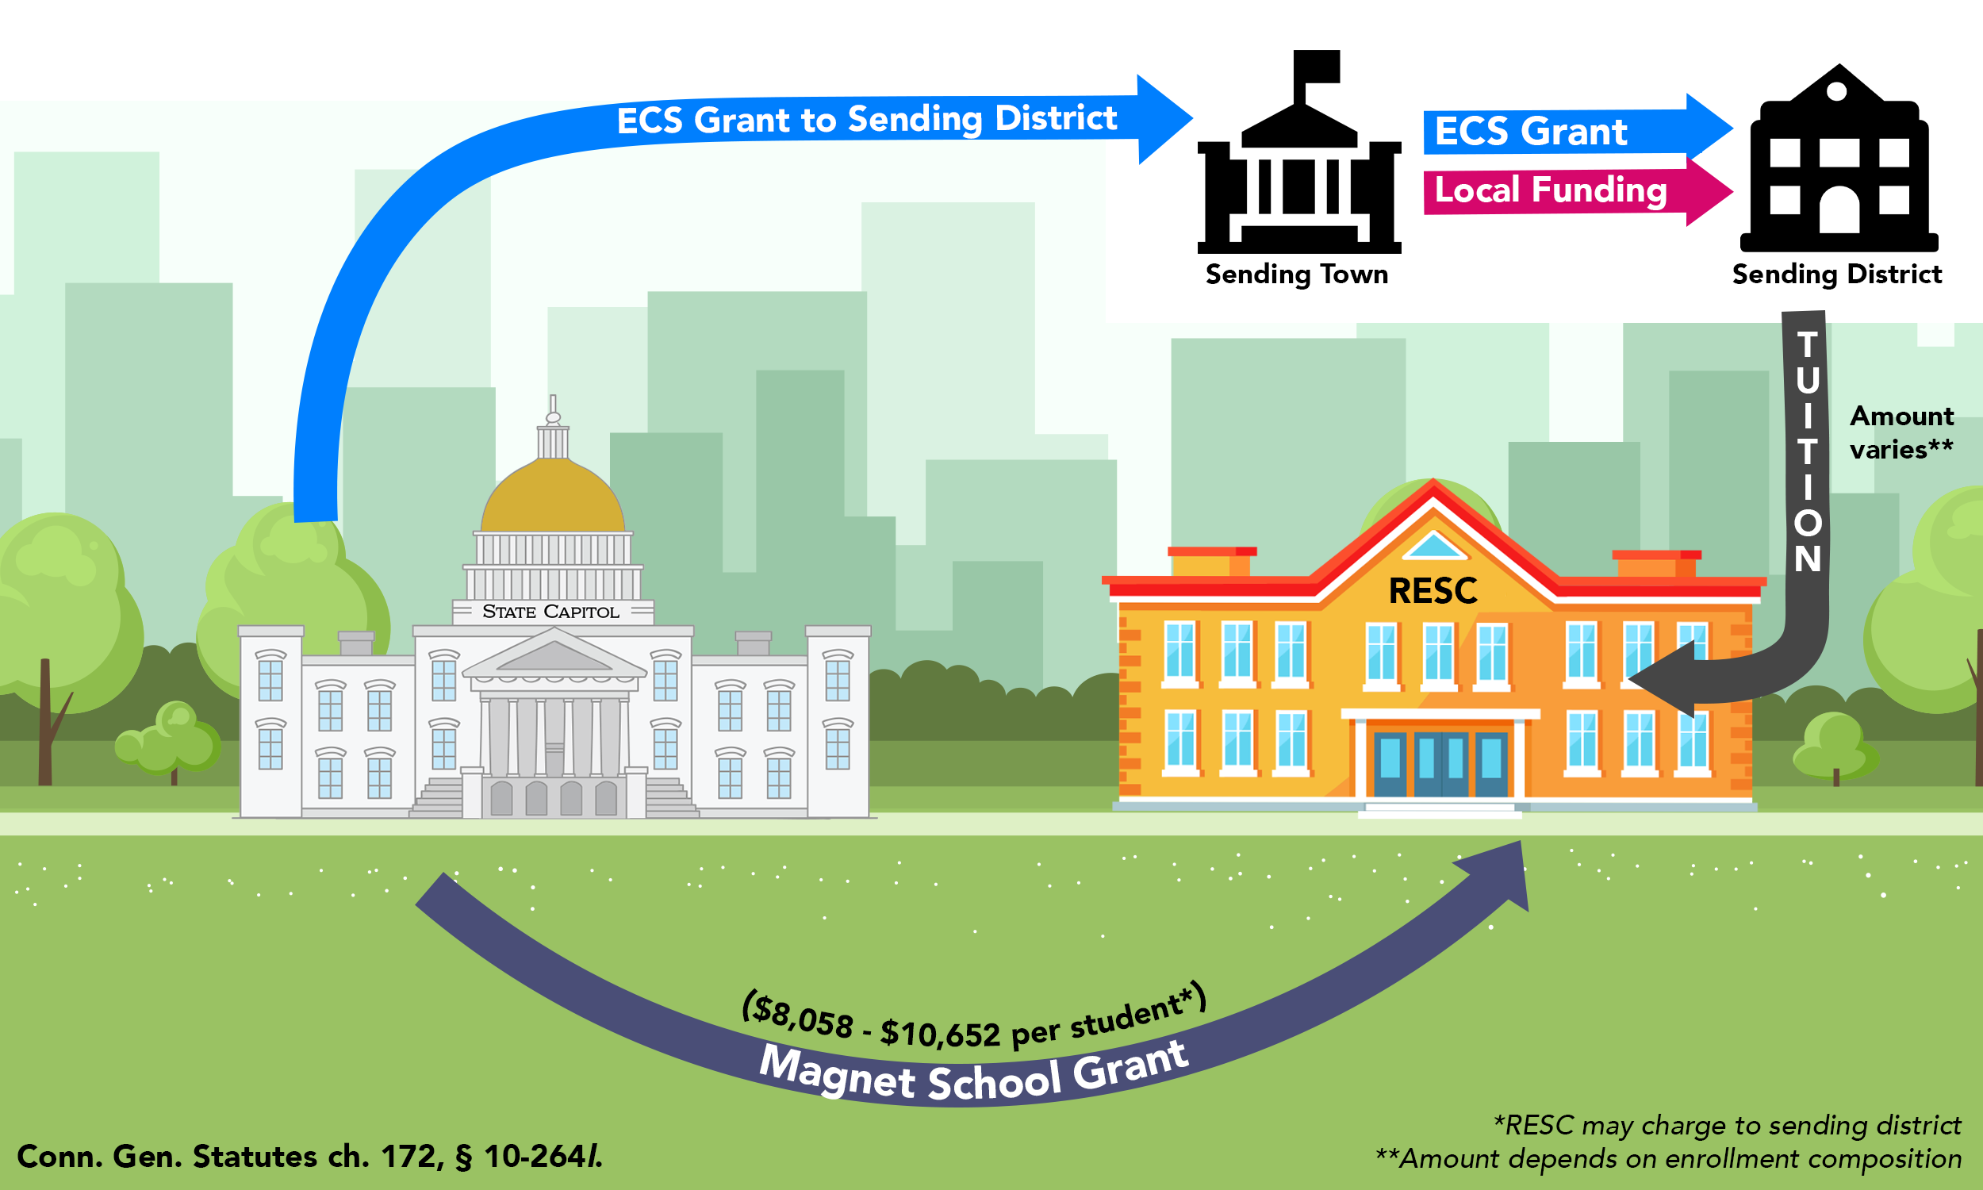
Regional Educational Service Center (RESC) Magnet School (Sheff)
(19 schools)

Slide 48
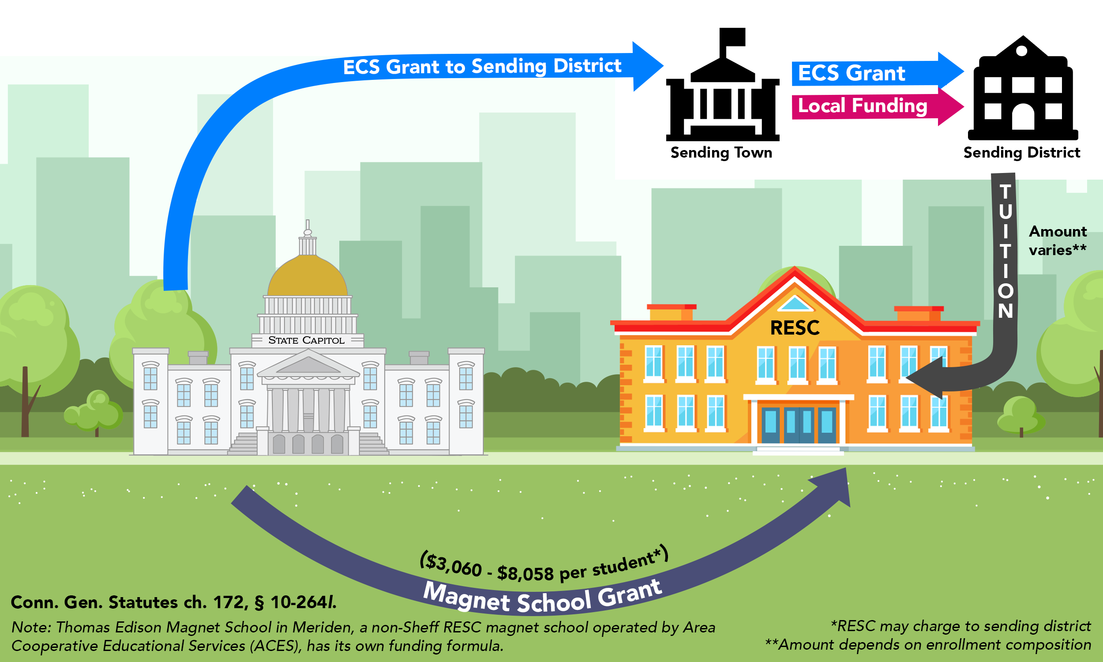
Regional Educational Service Center (RESC) Magnet School (Non-Sheff)
(12 schools)

Slide 49
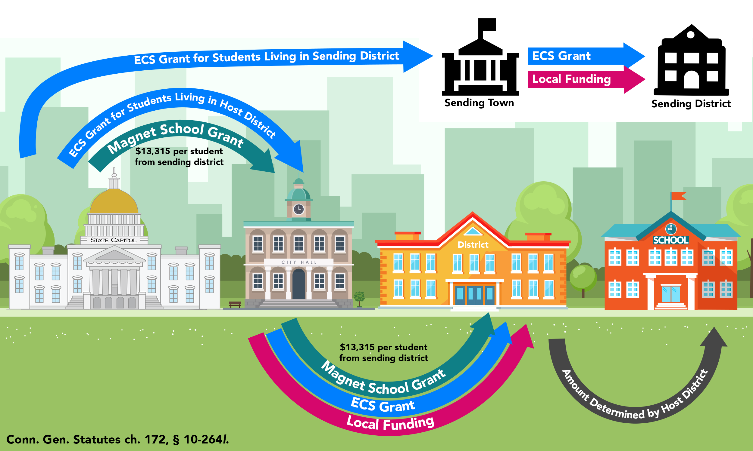
Host District Magnet (Sheff)
(21 schools)

Slide 50
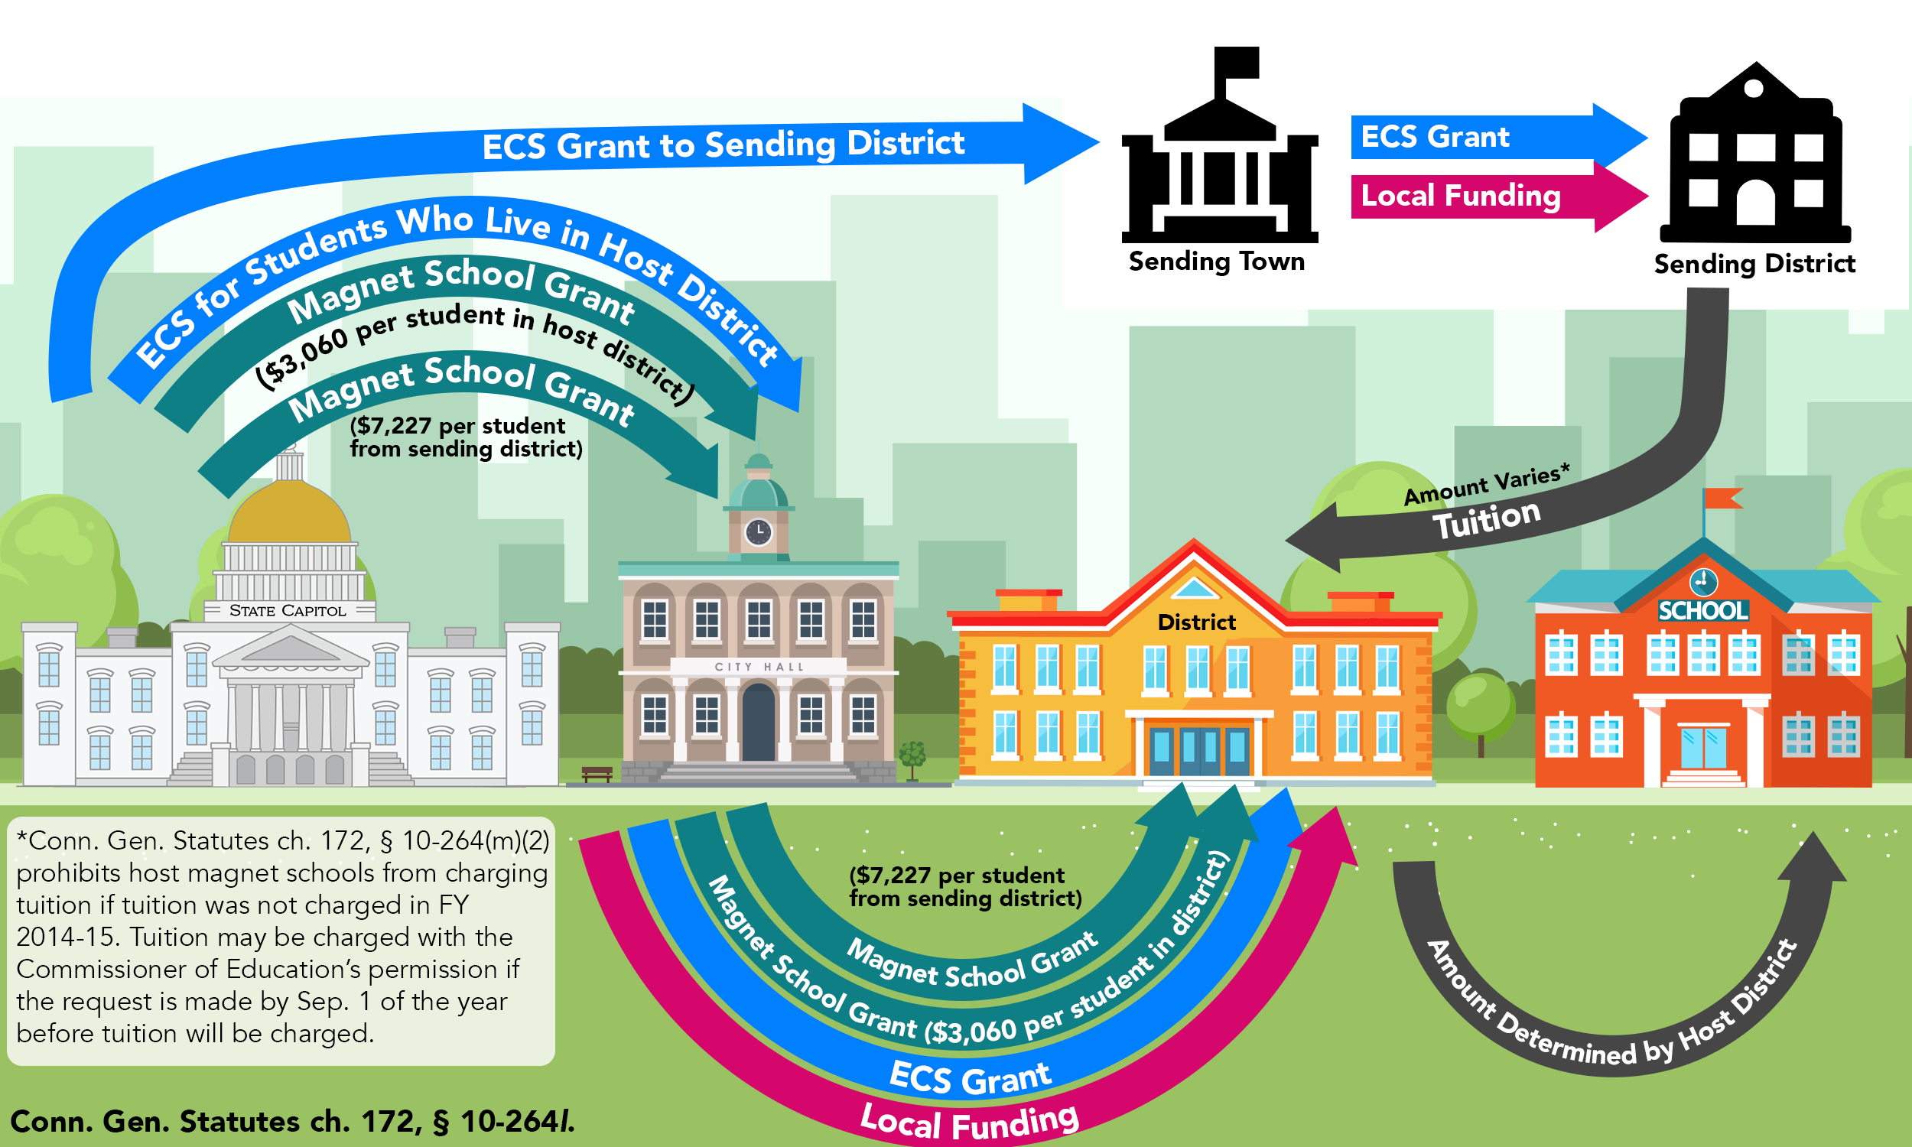
Host District Magnet (Non-Sheff)
(34 schools)

Slide 51
Connecticut’s other education funding formulas are not based on student learning needs

Slide 52
What You Can Do

Slide 53
Participate on a Local Level
Attend Board of Education Meetings meetings.
Submit public testimony at the Board of Education and Town Council during budget season.
Reach out to local decision makers to ask questions, begin a conversation about education funding, or ask them to support state initiatives that will benefit your community.

Slide 54
Participate on a State Level
Reach out to your State Representative and Senator.
If you aren’t sure who your legislators are, you can find out here.
Not sure what to say? Reach out to us for helpful tips here!

Slide 55
Add Your Voice to the Conversation
Talk abut school finance with others
Attend local municipal meetings such as the board of education, city/town council, or subcommittee meetings
Host a workshop or meeting with us
Attend a Wednesday workshop
Stay informed and help keep others informed
Let elected officials know school finance is an important issue for kids in your community

